Slide 1

GROUP-6 CRM SALESFORCE PROJECT
ANJUPRIYA
ANURADHA
USHARANI
ABHINASH
SRIKANTH

Slide 2
Project summary
The primary objective of the project is to implement and optimize Salesforce CRM to enhance customer relationship management, streamline sales processes, and improve marketing and service capabilities. The project aims to provide a centralized platform for managing leads, opportunities, customer interactions, and performance analytics.

Slide 3
KPI LIST
Total Leads Generated Measures overall lead inflow in the system.
Lead Conversion Rate Tracks how many leads successfully converted to customers.
Opportunity Win Rate Percentage of closed-won vs. total opportunities.
Expected vs. Forecasted Revenue Helps track revenue confidence and accuracy.
Leads/Opportunities by Source & Industry Identifies which channels and industries perform best.
Sales Stage Distribution Visualizes lead or deal volume at each stage of the sales cycle.
Closed Won Amount Displays confirmed revenue from successfully closed deals.

Slide 4
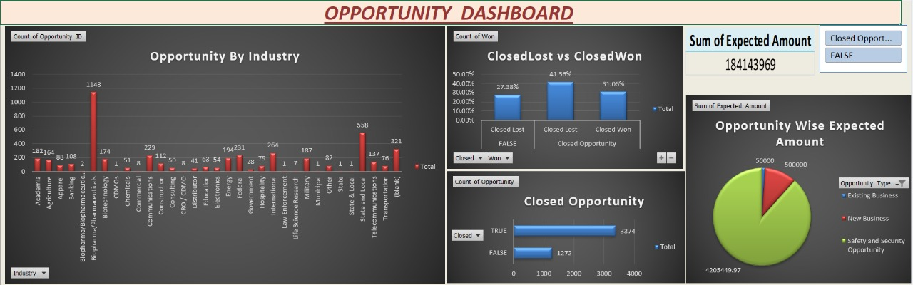
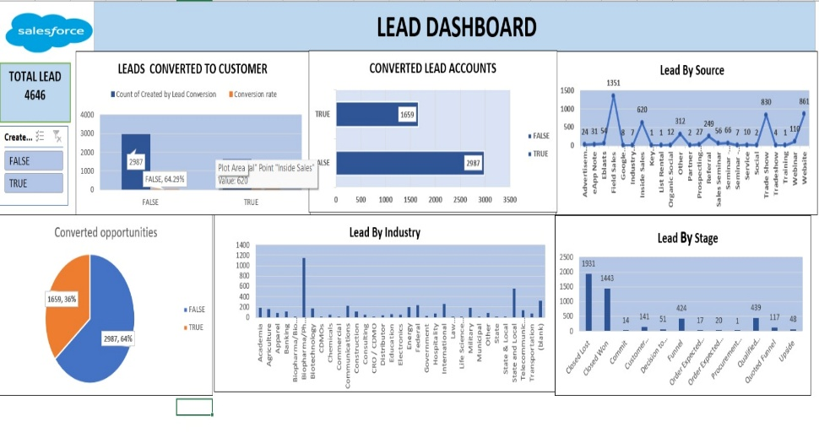
Excel Dashboard
Excel dashboards present a comprehensive snapshot of total leads, conversions, and opportunity breakdowns.
Segmentation by industry, lead source, and sales stage supports deeper pipeline analysis.
Visual tools like bar graphs and pie charts make trends and gaps easy to identify.
Filters and slicers enhance interactivity for on-the-spot exploration of specific segments.

Slide 5
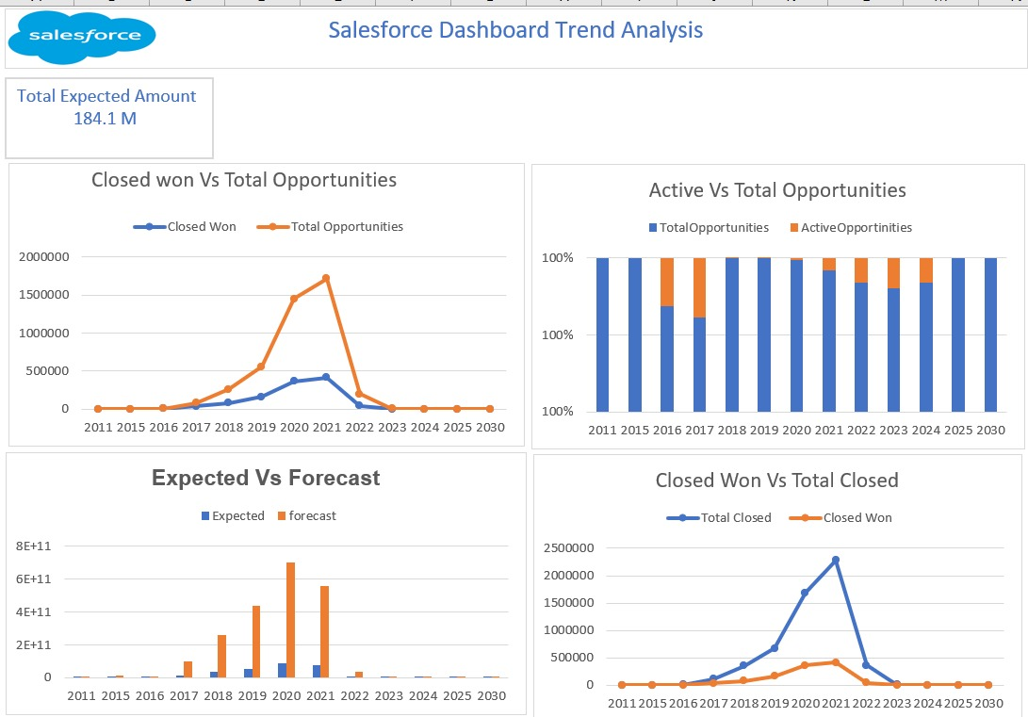
Trend analysis of Excel
Excel enables conversion analysis — helping identify which stages are performing and which need improvement.
Real-time indicators (like conversion percentages) support faster decision-making.
Historical comparisons and lead source effectiveness can be easily tracked.
Visual breakdowns of expected revenue help in prioritizing high-potential opportunities.

Slide 6
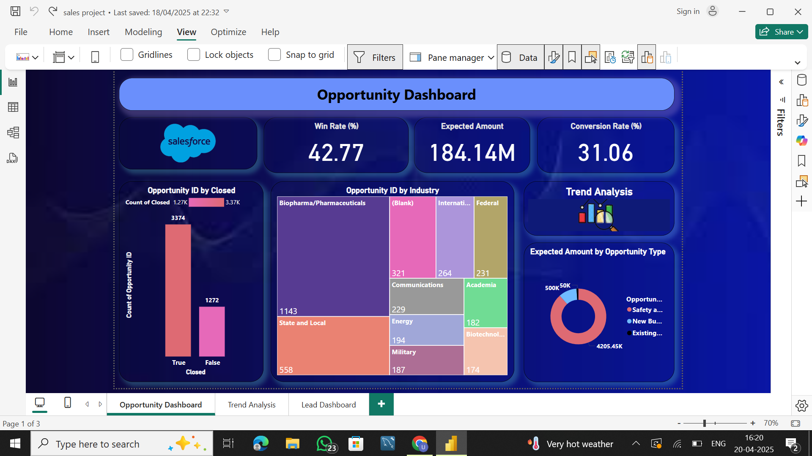
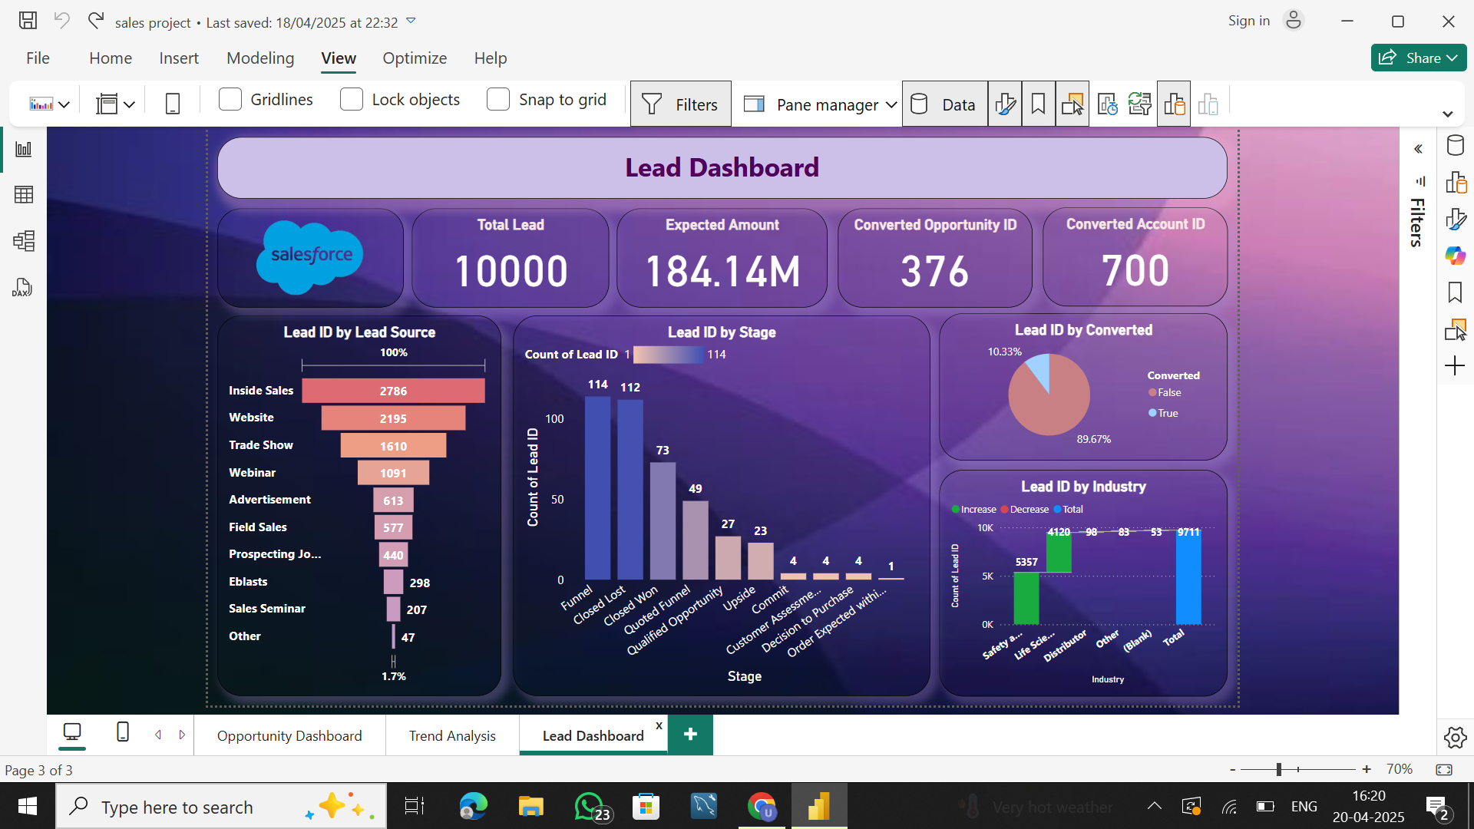
Power BI for Sales and Opportunity Tracking
Power BI transforms raw Salesforce data into actionable insights, enabling better control over the sales funnel.
Sales teams can easily track performance by region, industry, and opportunity status – helping focus efforts where it matters most.
The dashboard highlights which lead sources are most effective, helping allocate marketing budgets strategically.
With quick drill-downs into pipeline stages, teams can identify stalled deals and re-engage them.

Slide 7
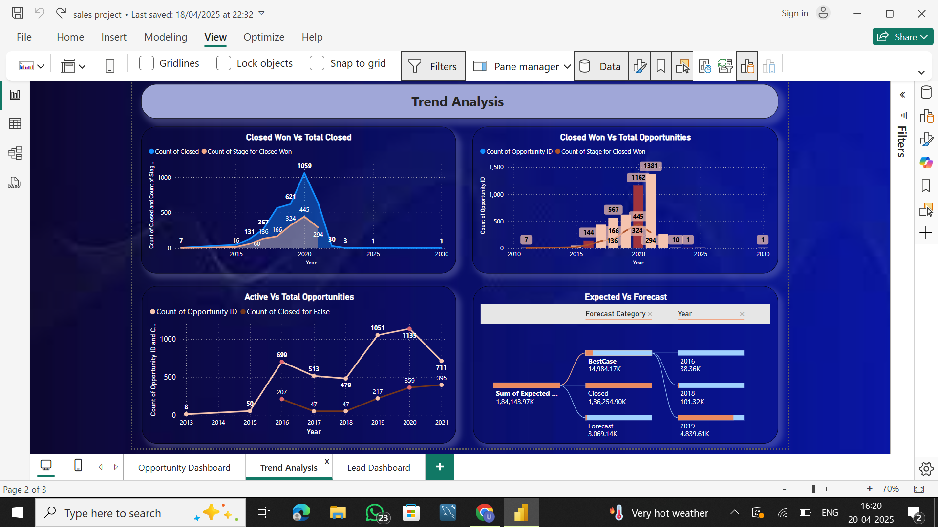
Driving Strategy Through Trend Analysis
Trend visuals in Power BI showcase how the sales journey has evolved over the years – highlighting growth opportunities and seasonal dips.
By comparing forecasts with actual closures, the dashboard helps improve accuracy and build trust in sales projections.
Business leaders can make proactive decisions by identifying when and why conversion rates fluctuate.
Power BI empowers stakeholders to shift from reactive to predictive sales strategies using real-time data trends.

Slide 8
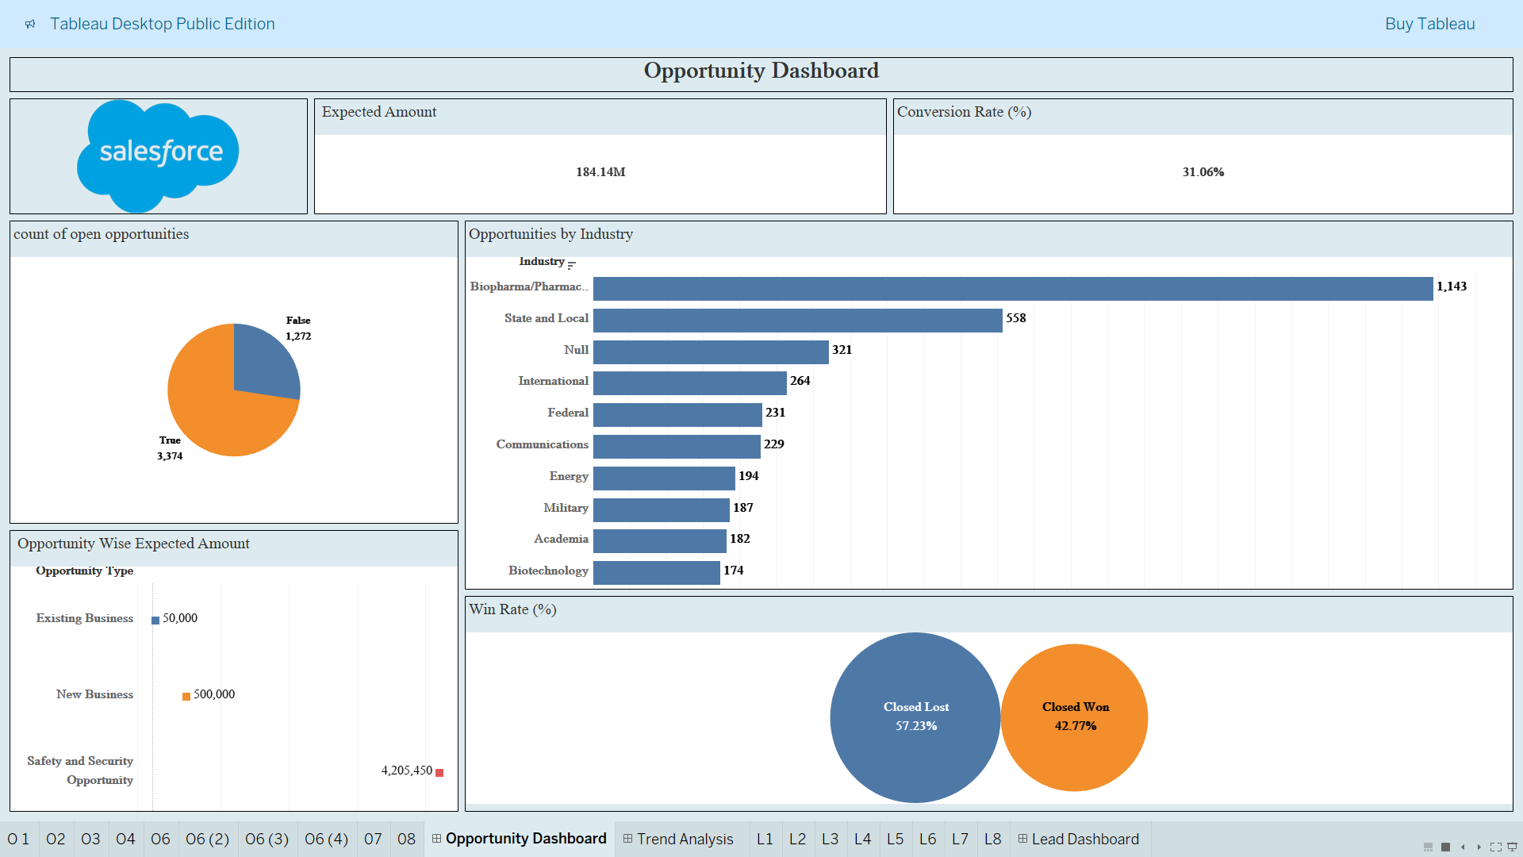
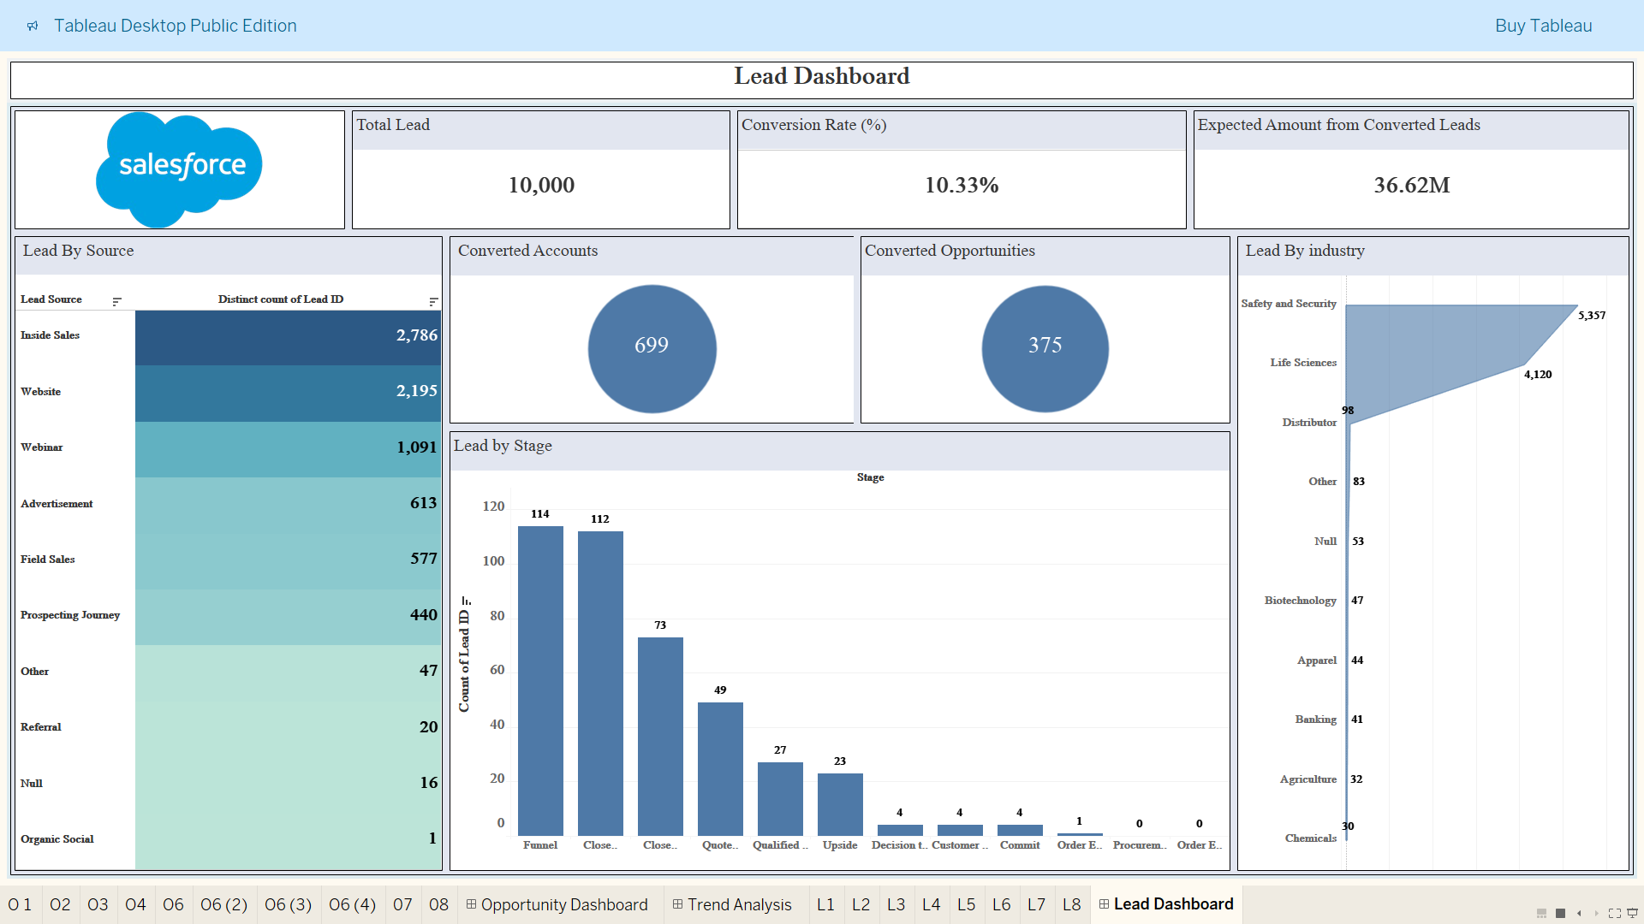
Tableau for Sales and Opportunity Tracking
Tableau enables dynamic dashboards where sales data can be filtered and sliced across dimensions like region, product, and industry.
Visualizations such as heat maps and bar charts make it easy to spot high-performing sales channels and underperforming segments.
Real-time opportunity tracking helps the team stay aligned on targets and deal closure status.
Sales reps and managers can quickly assess which industries or territories need more attention.

Slide 9
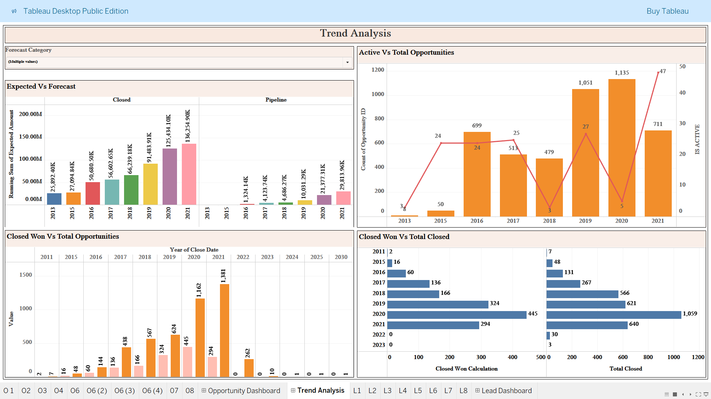
Smarter Sales Through Tableau
Tableau uncovers sales trends over time, helping forecast future revenue and seasonality with confidence.
The dashboard reveals conversion patterns, helping identify why some leads succeed and others don’t.
Business users can make faster decisions by visually comparing planned vs. actual performance in one place.

Slide 10
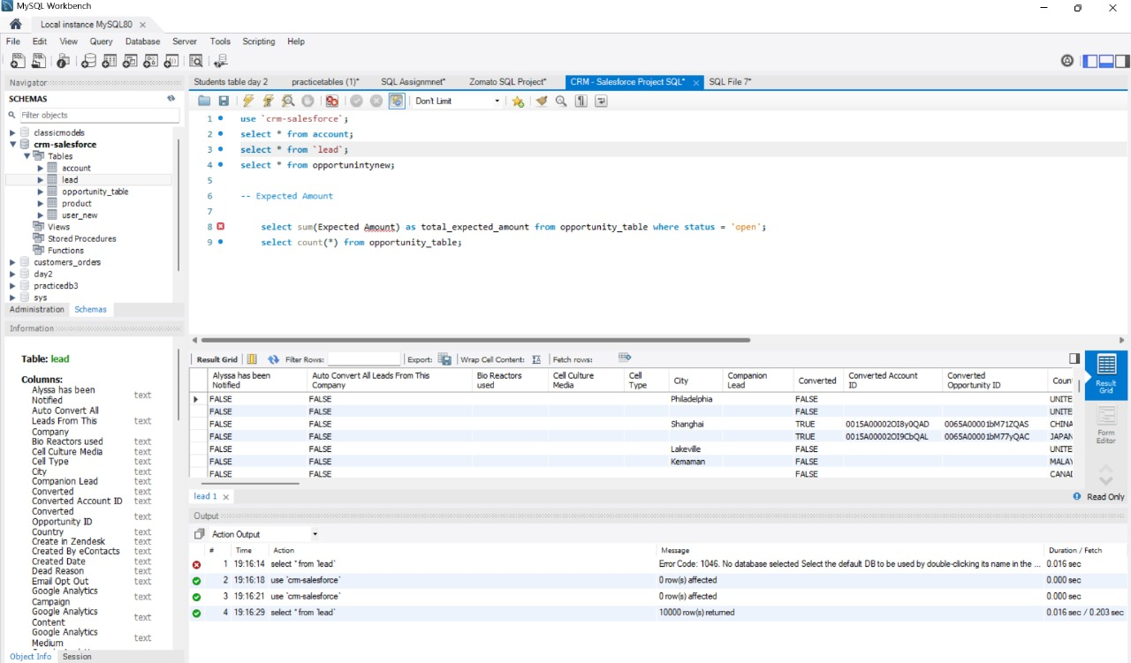
SQL Query Image
Schema

Slide 11
Queries used for Data Transformation
Filter Converted Leads
Create a Dimensional Table for Leads (Dim Lead)
Create a Fact Table for Lead Activity (Fact Lead Status)
Group Leads by Industry
Track Lead Conversion Time

Slide 12
Key Takeaways
Business Insights
Lead Source Effectiveness: Leads originating from web forms and referral campaigns show the highest conversion rates—suggesting strong ROI from digital channels.
Sales Pipeline Visibility: Opportunity stages are clearly defined, with most deals stalling at the "Proposal/Price Quote" stage—highlighting a need for stronger deal-closing tactics.
Challenges
Low CRM Adoption: Some reps still log activities outside Salesforce, leading to visibility gaps and incomplete reporting.
Poor Data Quality: Duplicate records, missing fields (e.g., industry, revenue), and outdated contact info are prevalent in many leads and accounts.
Future Recommendations
Mandatory Fields & Validation Rules: Enforce critical field completion during data entry to improve lead and account quality.
Automated Lead Assignment Rules: Use territory management and assignment rules to instantly route leads to the right reps
Adoption Push via Training & Dashboards: Provide targeted training, mobile access, and custom dashboards to improve usage among sales teams

Slide 13
THANK YOU

